Slide 1
BT5110 Project Presentation
Project Group 12
YU Zhen A0160895U
Lu HE A0160883Y
YAU Chung Yin A0160936B

Slide 2
Original TPC-H Schema
CUSTOMER
C_CUSTKEY
C_NAME
C_ADDRESS
C_NATIONKEY
C_PHONE
C_ACCTBAL
C_MKTSEGMENT
C_COMMENT
LINEITEM
L_ORDERKEY
L_PARTKEY
L_SUPPKEY
L_LINENUMBER
L_QUANTITY
L_EXTENDEDPRICE
L_DISCOUNT
L_TAX
L_RETURNFLAG
L_LINESTATUS
L_SHIPDATE
L_COMMITDATE
L_RECEIPTDATE
L_SHIPINSTRUCT
L_SHIPMODE
L_COMMENT
ORDERS
O_ORDERKEY
O_CUSTKEY
O_ORDERSTATUS
O_TOTALPRICE
O_ORDERDATE
O_ORDERPRIORITY
O_ORDERCLERK
O_SHIPPRIORITY
O_COMMENT
PARTSUPP
PS_PARTKEY
PS_SUPPKEY
PS_AVAILQTY
PS_SUPPLYCOST
PS_COMMENT
NATION
N_NATIONKEY
N_REGIONKEY
N_NAME
N_COMMENT
REGION
R_REGIONKEY
R_NAME
R_COMMENT
PART
P_PARTKEY
P_NAME
P_MFGR
P_BRAND
P_TYPE
P_SIZE
P_CONTAINER
P_RETAILPRICE
P_COMMENT
SUPPLIER
S_SUPPKEY
S_NAME
S_ADDRESS
S_NATIONKEY
S_PHONE
S_ACCTBAL
S_COMMENT

Slide 3
Demo - TPC-H Schema
http://localhost/dashboard1.1.php

Slide 4
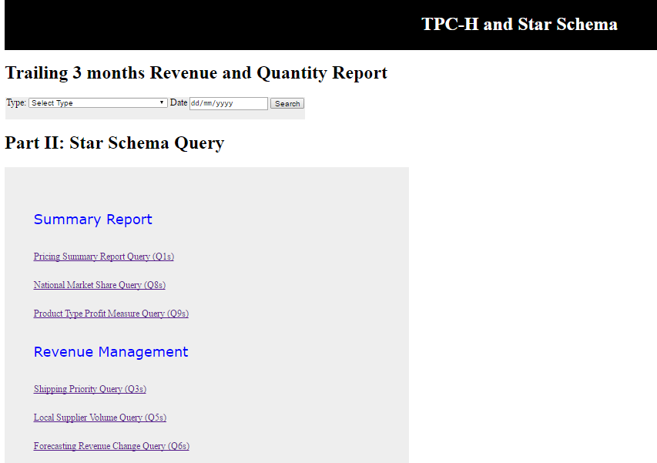
Dashboard - Directory

Slide 5
Dashboard - Directory
Revenue summary report for the C-suites
Quick directory to all queries by category
Easy switch between TPC-H and Star Schema

Slide 6
Dashboard - Queries
Date and value constraints
Calendar selection of dates
Dropdown selection of values
Input records
Column in layman terms
Values with max 2 decimal places

Slide 7
STAR-Schema – Summary
CUSTOMER_S
C_CUSTKEY
C_NAME
C_ADDRESS
C_PHONE
C_ACCTBAL
C_MKTSEGMENT
C_NATION
C_REGION
C_COMMENT
PART_S
P_PARTKEY
P_NAME
P_MFGR
P_BRAND
P_TYPE
P_SIZE
P_CONTAINER
LINEORDER_S
L_ORDERKEY | L_PARTKEY
L_LINENUMBER | L_SUPPKEY
L_CUSTKEY | L_SHIPMODE
L_RETURNFLAG | L_SHIPINSTRUCT
L_LINESTATUS | L_SHIPPRIORITY
L_ORDERSTATUS | L_QUANTITY
L_ORDERPRIORITY | L_EXTENDEDPRICE
L_ORDERDATEKEY | L_DISCOUNT
L_COMMITDATEKEY | L_TAX
L_SHIPDATEKEY | L_REVENUE
L_RECEIPTDATEKEY | L_TOTALPRICE
PARTSUPP_S
PS_PARTKEY
PS_SUPPKEY
PS_AVAILQTY
PS_SUPPLYCOST
SUPPLIER_S
S_SUPPKEY
S_NAME
S_ADDRESS
S_PHONE
S_ACCTBAL
S_NATION
S_REGION
S_COMMENT
DATE_S
D_DATEKEY
D_DATE
D_MONTH
D_YEAR
FACT TABLES
DIMENSION TABLES

Slide 8
STAR-Schema – 4 steps
Step 1: Business processes to model
Sales/Orders
Step 2: Grain of the business process
Sales/Orders: a line item on a customer‘s order
Purchase/Inventory
Purchase/Inventory: a snapshot of the inventory level of a specific part from a specific supplier
Step 3: Choose the dimension that apply to each fact table
Customer
Supplier
Part
Date (Newly Added)

Slide 9
STAR-Schema – 4 steps (CONT’D)
Step 4: Identify the numeric facts that will populate each fact table
Sales/Orders
Purchase/Inventory
Addictive fact: Quantity, Extended Price, Revenue (extended price after discount), Total Price
Non-addictive fact: Discount, Tax, etc.
Other attributes: Shipment, Priority, etc.
Dimensions: Customer, Supplier, Part, Date
Facts: Cost and Available Quantity
Dimensions: Supplier, Part

Slide 10
STAR-Schema – Improvements
Separate the information of Sales/Order with Purchase/Inventory
Combine LINEITEM and ORDERS to have the lowest possible grain of each dimension
De-normalised NATION and REGION tables
Drop unnecessary columns:
P_RETAILPRICE, P_COMMENT, O_COMMENT, PS_COMMENT, O_ORDERCLERK, L_COMMENT
Add DATE dimension with use of surrogate key
Add frequently-used fact to improve query performance: L_REVENUE

Slide 11
Original TPC-H Schema
CUSTOMER
C_CUSTKEY
C_NAME
C_ADDRESS
C_NATIONKEY
C_PHONE
C_ACCTBAL
C_MKTSEGMENT
C_COMMENT
LINEITEM
L_ORDERKEY
L_PARTKEY
L_SUPPKEY
L_LINEITEM
L_QUANTITY
L_EXTENDEDPRICE
L_DISCOUNT
L_TAX
L_RETURNFLAG
L_LINESTATUS
L_SHIPDATE
L_COMMITDATE
L_RECEIPTDATE
L_SHIPINSTRUCT
L_SHIPMODE
L_COMMENT
ORDERS
O_ORDERKEY
O_CUSTKEY
O_ORDERSTATUS
O_TOTALPRICE
O_ORDERDATE
O_ORDERPRIORITY
O_ORDERCLERK
O_SHIPPRIORITY
O_COMMENT
PARTSUPP
PS_PARTKEY
PS_SUPPKEY
PS_AVAILQTY
PS_SUPPLYCOST
PS_COMMENT
NATION
N_NATIONKEY
N_REGIONKEY
N_NAME
N_COMMENT
REGION
R_REGIONKEY
R_NAME
R_COMMENT
PART
P_PARTKEY
P_NAME
P_MFGR
P_BRAND
P_TYPE
P_SIZE
P_CONTAINER
P_RETAILPRICE
P_COMMENT
SUPPLIER
S_SUPPKEY
S_NAME
S_ADDRESS
S_NATIONKEY
S_PHONE
S_ACCTBAL
S_COMMENT

Slide 12
STAR-Schema – Summary
CUSTOMER_S
C_CUSTKEY
C_NAME
C_ADDRESS
C_PHONE
C_ACCTBAL
C_MKTSEGMENT
C_NATION
C_REGION
C_COMMENT
PART_S
P_PARTKEY
P_NAME
P_MFGR
P_BRAND
P_TYPE
P_SIZE
P_CONTAINER
LINEORDER_S
L_ORDERKEY | L_PARTKEY
L_LINEITEM | L_SUPPKEY
L_CUSTKEY | L_SHIPMODE
L_RETURNFLAG | L_SHIPINSTRUCT
L_LINESTATUS | L_SHIPPRIORITY
L_ORDERSTATUS | L_QUANTITY
L_ORDERPRIORITY | L_EXTENDEDPRICE
L_ORDERDATEKEY | L_DISCOUNT
L_COMMITDATEKEY | L_TAX
L_SHIPDATEKEY | L_REVENUE
L_RECEIPTDATEKEY | L_TOTALPRICE
PARTSUPP_S
PS_PARTKEY
PS_SUPPKEY
PS_AVAILQTY
PS_SUPPLYCOST
SUPPLIER_S
S_SUPPKEY
S_NAME
S_ADDRESS
S_PHONE
S_ACCTBAL
S_NATION
S_REGION
S_COMMENT
DATE_S
D_DATEKEY
D_DATE
D_MONTH
D_YEAR
FACT TABLES
DIMENSION TABLES

Slide 13
Demo - star-Schema
http://localhost/dashboard2.2.php

Slide 14
Q&a

